Slide 1
Intro for Causality
Dinghuai Zhang 2020.4

Slide 2
Two branches
Donald Rubin
potential outcome
goal: causal effect
bio-stats & bio-medical

Slide 3
Two branches
Judea Pearl
Directed Acyclic Graph (DAG)
causal discovery
stats & ml

Slide 4
Bernhard Schölkopf

Slide 5
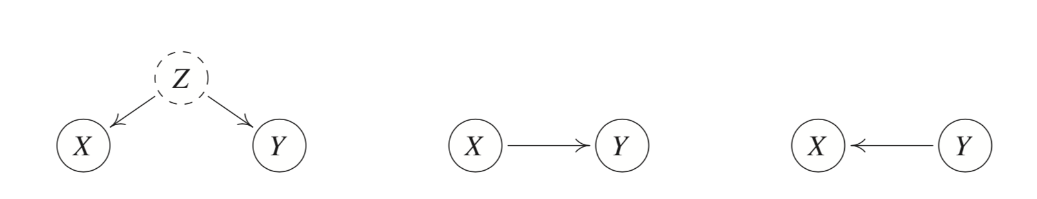
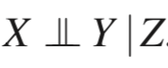
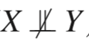
Confounder

Slide 6
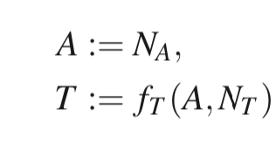
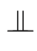
Structral Causal Model (SCM)
A → T
independence of cause and mechanism:
N_A N_T
p(a,t) = p(a)p(t|a)

Slide 7
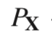
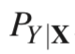
connection with SSL
Semi-supervised learning used unlabeled X to help
if and are indeed independent,
then SSL won’t help
therefore, all cases where SSL helps is anti-causal

Slide 8
p(a,t) = p(a)p(t|a) or p(t)p(a|t) ?
IF
intervening on A has changed T , but intervening on T has not changed A
THEN
we think A → T

Slide 9
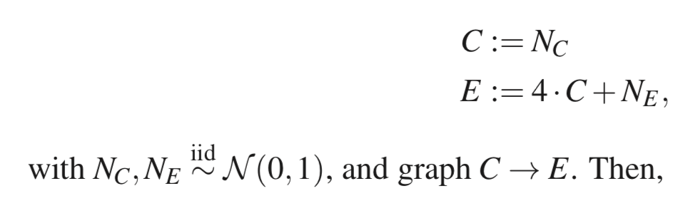
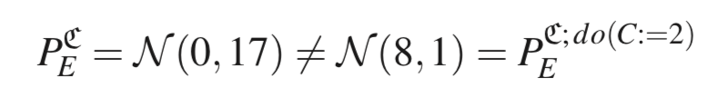
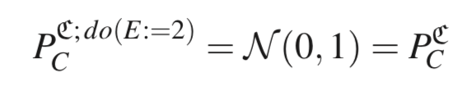
Intervention
C → E (cause → effect)

Slide 10
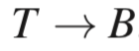
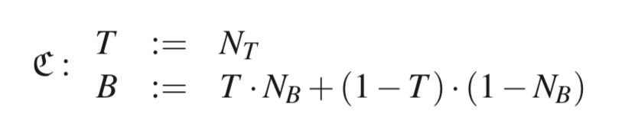
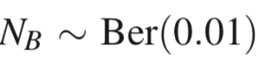
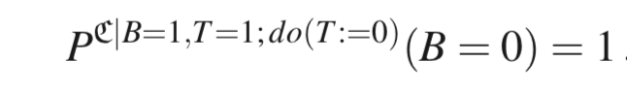
Counterfactual
T = 1: with treatment
N_B = 0: normal patient N_B = 1: rare patient
B = 0: healthy B = 1: blind

Slide 11
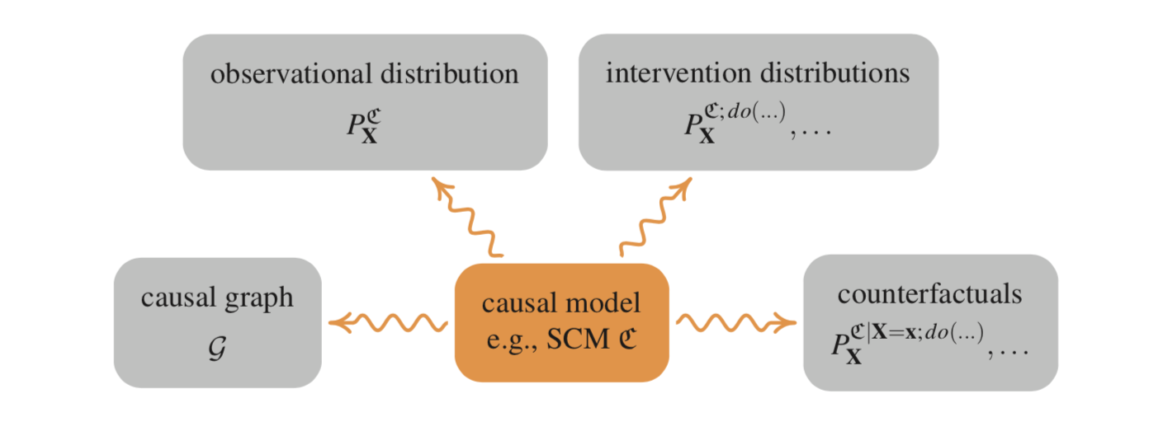

Slide 12
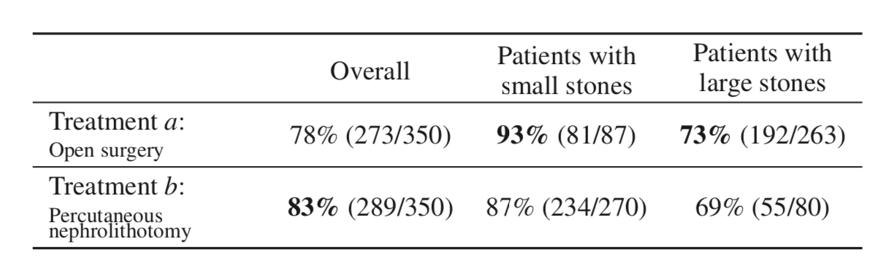
Simpson’s paradox
conditional prob compare:

Slide 13
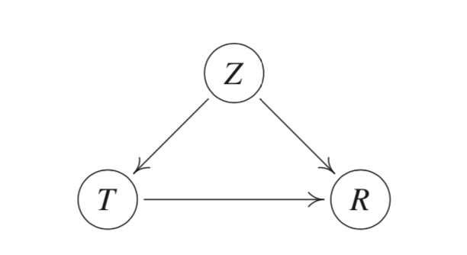
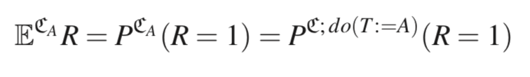
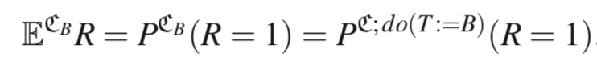
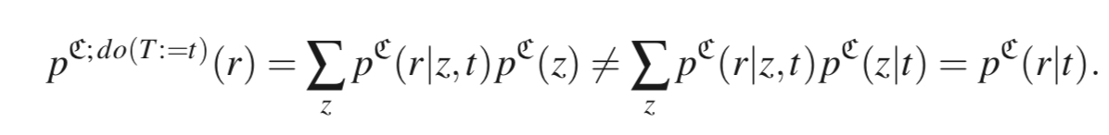
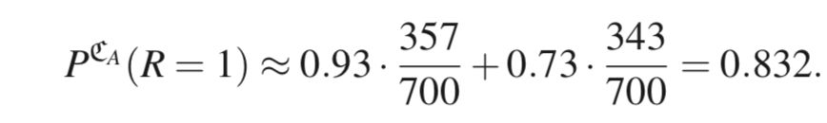
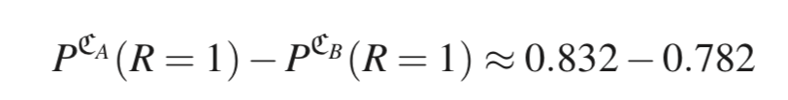
Z: size of the stone
R: whether recovery
instead of compare conditional probability
we should compare intervention probability:

Slide 14
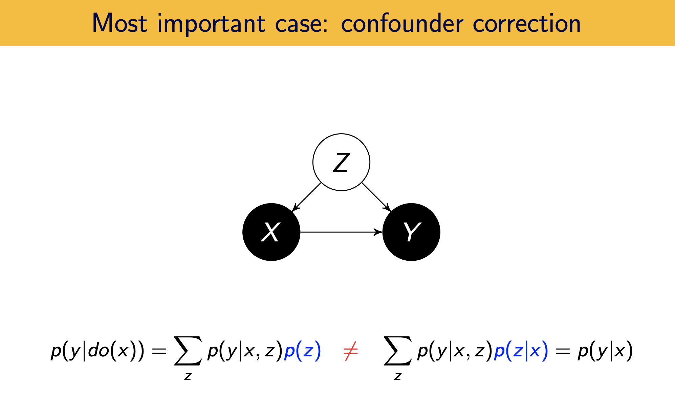
If equal, then X -> Y

Slide 15
Learning Cause-Effect
Identifiability
additional assumptions are required

Slide 16
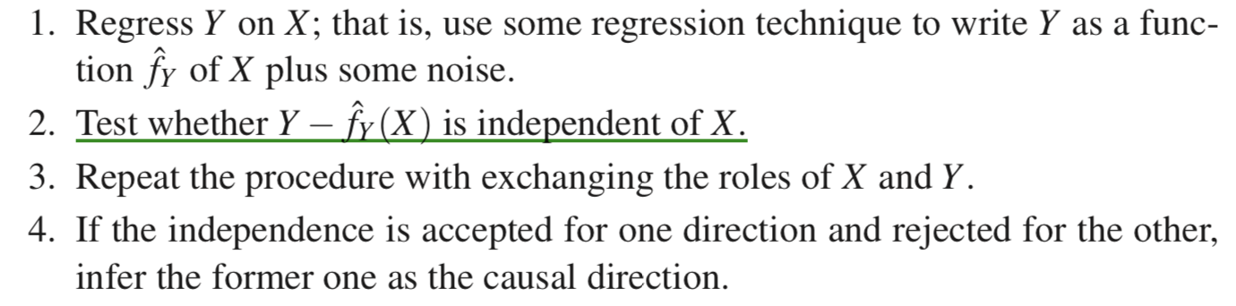
Structure Identification
Given (X, Y) ~ dataset

Slide 17
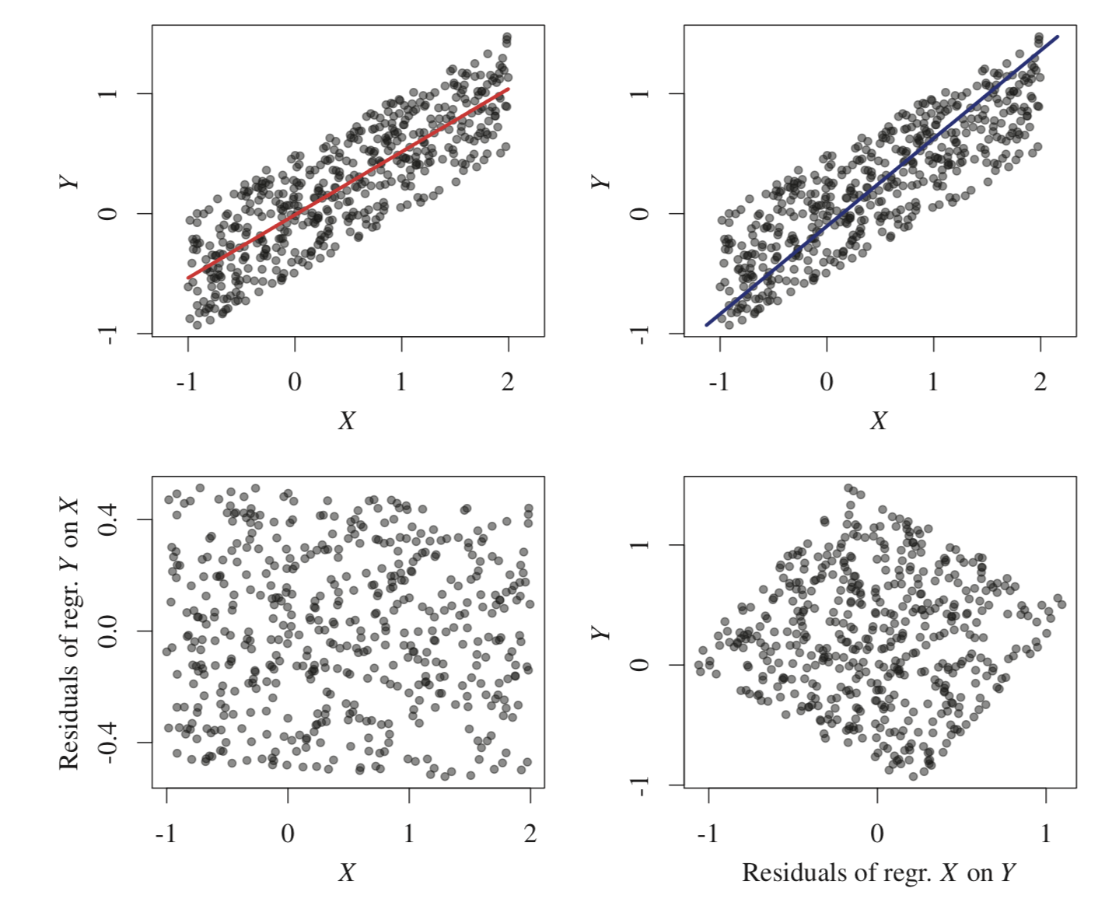

Slide 18
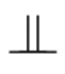
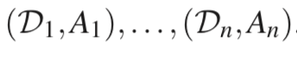
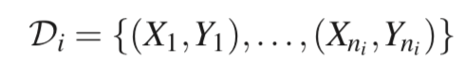
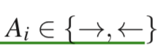
Alternative approach
compare independence:
p(x) p(y|x) or p(y) p(x|y) ?
Supervised learning approach

Slide 19
Thank you for listening

